Slide 1
ACMA 231
Excel: Functions Part 3

Slide 2
INDEX (array, row_num, [column_num])
Excel: Functions Part 3 ~ INDEX
Range of data you are using
Relative column number within the grid of selected data that you are trying to identify
Relative row number within the grid of selected data that you are trying to identify
The INDEX function is very useful for larger datasets and in conjunction with other functions. Usually, you’ll be using other functions as inputs into the INDEX function.
Most of the time, you’ll use VLOOKUP instead because it is more efficient from a memory usage perspective, but there will be times when INDEX is necessary when VLOOKUP is less handy.

Slide 3
OFFSET (reference, rows, columns)
Excel: Functions Part 3 ~ OFFSET and MATCH
Starting (origin) cell
How many columns to the right from the origin?
How many rows down from the origin?
MATCH (lookup value, lookup array, [match type])
What am I trying to match?
What range of cells am I looking into for my lookup value?
Do I want an exact match 0 or an approximate match 1 ?
Will return the reference position number. Super useful within other functions, like VLOOKUP, INDEX, and OFFSET

Slide 4
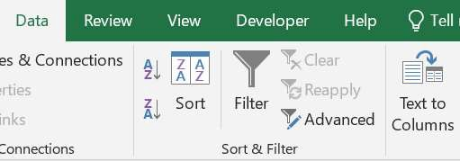
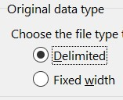
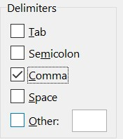
Excel: Functions Part 3 ~ Text to Columns
Many times, to save on space, databases will store data in simpler formats, like comma separated values (csv). In order to take the raw data and translate it into a grid format like we have in Excel, we can use the Text to Columns tool.
After pasting (or inserting) your data into the worksheet, oftentimes all in column A, highlight the data.
After highlighting, go to the Data tab on the ribbon and select Text to Columns
If your data is separated with special characters, like commas, choose “Delimited”. If you want to manually select how the data is split, choose “Fixed width”. Click Next.
Select the special character that separates your data.You’ll see a preview of how the data will be split below. Click Next. On the next screen, you will almost always select “General” and then Finish.
If you want to manually select how the data is split, after choosing “Fixed Width”, the next screen will allow you to make your column split selections.

Slide 5
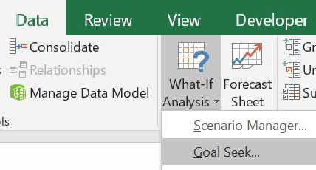
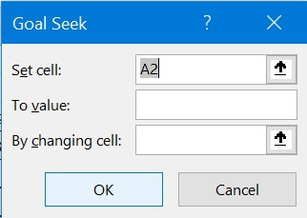
Excel: Functions Part 3 ~ Goal Seek
Sometimes, you’ll have several pieces of data, but you need to find another piece by converging on an answer by allowing some other variable to fluctuate. This situation comes up quite frequently in Finance and as an Actuary. We can use the Goal Seek tool to do this.
Go to the Data tab on the ribbon and select What-If Analysis. In the dropdown,
select Goal Seek.
Which cell am I fixing to a certain value?
What value am I aiming for? Note that this is usually zero because we are often using Goal Seek for convergence purposes. It can be anything you want, though.
Which cell is allowed to fluctuate?

